Slide 1

“ENGINEERING CLINICS”
FALL 2022-23
TOPIC: ELEVATOR USING AURDINO

Slide 2
Guide Prof. Ganesh Lakshman Kumar Moganti TEAM:
R. Rasagna -21mic7025
S.Amrutha -21mic7048
K.L.Bharadwaj -21mic7050
T.Sree -21mic7058
A.Madhu -21mis7022
P.Nikhilesh -21mis7087

Slide 3
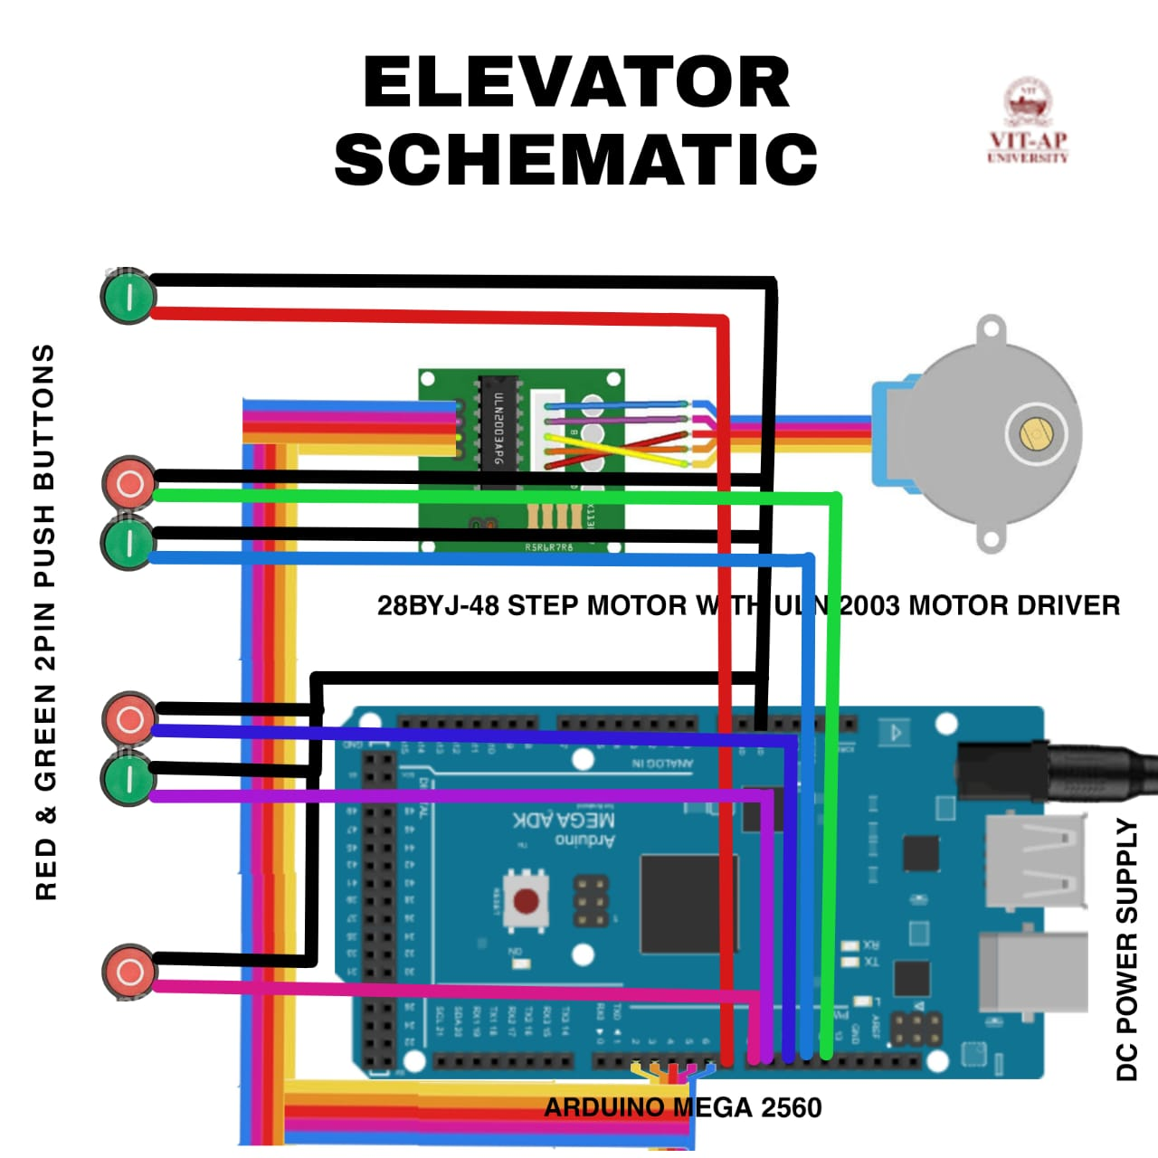
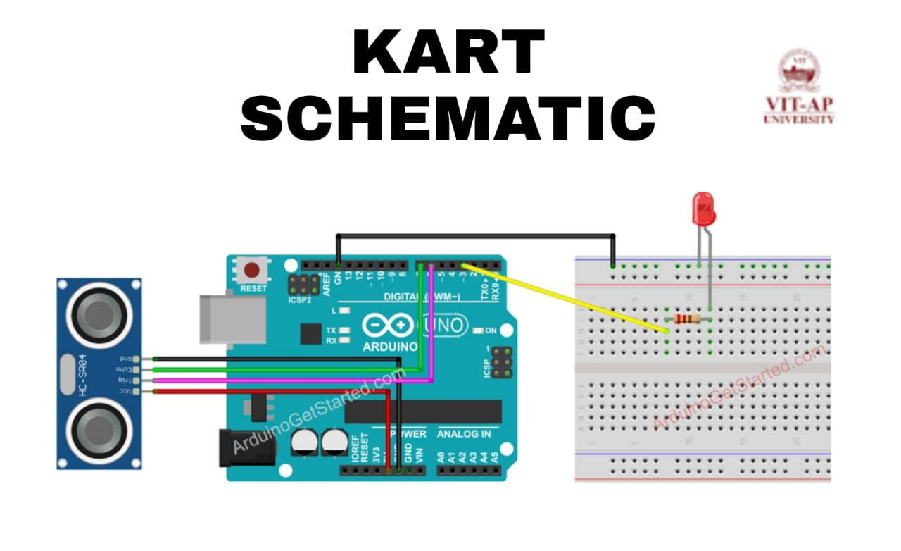
CIRCUIT :

Slide 4
CODE :
const int CW =1;
const int CCW =2;
const int STOP =3;I
nt Pin1 = 2;//IN1 is connected to 8 int Pin2 = 3;//IN2 is connected to 9 int Pin3 = 4;//IN3 is connected to 10 int Pin4 = 5;//IN4 is connected to 11int switchSTOP =2;//define input pin for STOP push buttonint stopType=1;//1=normal stop, 2=hold stop (consumes power)int speedFactor =1;//1=fastest, 2=slower or 3 more slower
long angles[] = {2880, 2880, 1000, 2790, 2790.5, 1500};//angles of each push buttonint pushButtons[] ={6, 7, 8, 9, 10, 11};//digial pin for each push buttonint directions[] ={CCW, CW, CCW, CW, CCW, CW};//direction of eacch push buttonint speedFactors[] = {1, 1, 1, 1, 1, 1};//speed for each push button
int correction_CW = 150;int correction_CCW = 150;int poleStep = 0; long stepVale =0;const int SPR=64*64;long goToAngle=0;int activeButton=0;int pole1[] ={0,0,0,0, 0,1,1,1, 0};//pole1, 8 step valuesint pole2[] ={0,0,0,1, 1,1,0,0, 0};//pole2, 8 step valuesint pole3[] ={0,1,1,1, 0,0,0,0, 0};//pole3, 8 step valuesint pole4[] ={1,1,0,0, 0,0,0,1, 0};//pole4, 8 step values
int count=0;int dirStatus = STOP;// stores direction status 3= stop (do not change)void setup() { Serial.begin(9600); Serial.begin("elevator using arduino"); pinMode(Pin1, OUTPUT);//define pin for ULN2003 in1 pinMode(Pin2, OUTPUT);//define pin for ULN2003 in2 pinMode(Pin3, OUTPUT);//define pin for ULN2003 in3 pinMode(Pin4, OUTPUT);//define pin for ULN2003 in4 pinMode(switchSTOP,INPUT_PULLUP);
attachInterrupt(digitalPinToInterrupt(switchSTOP), stopMotor, FALLING ); for (byte i = 0; i < (sizeof(pushButtons) / sizeof(pushButtons[0])); i++) { pinMode(i,INPUT_PULLUP); } } //setup void loop() { stepVale = (SPR * goToAngle)/360 ; for (byte i = 0; i < (sizeof(angles) / sizeof(angles[0])); i++) { if(digitalRead(pushButtons[i]) == LOW) { goToAngle =angles[i]; dirStatus =directions[i]; count =0; activeButton =i; }// if ends }//for loop ends

Slide 5
if(dirStatus ==CCW){
poleStep++;
count++;
if(count+correction_CCW <= stepVale)
{
driveStepper(poleStep);
}else{
stopMotor();
}
//full explannation at Arduino Course on Udemy.com see link above
}else if(dirStatus ==CW){
poleStep--;
count++;
if(count+correction_CW <=stepVale)
{
driveStepper(poleStep);
}else{
stopMotor();
}
}else{
stopMotor();
}
if(poleStep>7){
poleStep=0;
}
delay(speedFactors[activeButton]);
//Robojax.com Stepper Push button Any Angle STPB-5
}// loop
void driveStepper(int c)
{
//Robojax.com Stepper Push button Any Angle STPB-5
digitalWrite(Pin1, pole1[c]);
digitalWrite(Pin2, pole2[c]);
digitalWrite(Pin3, pole3[c]);
digitalWrite(Pin4, pole4[c]);
}//driveStepper ends here
void stopMotor()
{
for (byte i = 0; i < (sizeof(angles) / sizeof(angles[0])); i++) {
digitalWrite(pushButtons[i], HIGH);
}//for loop ends
dirStatus = STOP;
if( stopType ==2)
{
driveStepper(8);
}
}//stopMotor()

Slide 6
ALGORITHM
Here, The Pins Of The Uln2008 Driver Are Connected To The Digital Pins As Follwed Int 1-digital Pin 2 Int 2-digital Pin 3 Int3-digital Pin 4 Int4-digital Pin 5 Int5-digital Pin 6
Here, The Pins Of The Buttons Are Connected To The Digital Pins&gnd As Follwed Btn 1-digital Pin 6(ground Floor) Btn 2-digital Pin 7(3rd Floor-up) Btn3-digital Pin 8(1st Floor-up) Btn4-digital Pin 9(1st Floor-down) Btn5-digital Pin 10(2nd Floor-up) Btn6-digital Pin11(2nd Floor-down)
For Each Button There Are 2 Pins In Which One Pin Is Conected To Gnd And Another To The Digital Pinhere The Angles Of The Push Button Are {2880,2880,2250,2430,2880,1400}here The Direction Of The Each Push Button Is {Ccw,cw,ccw,cw,ccw,cw}

Slide 7
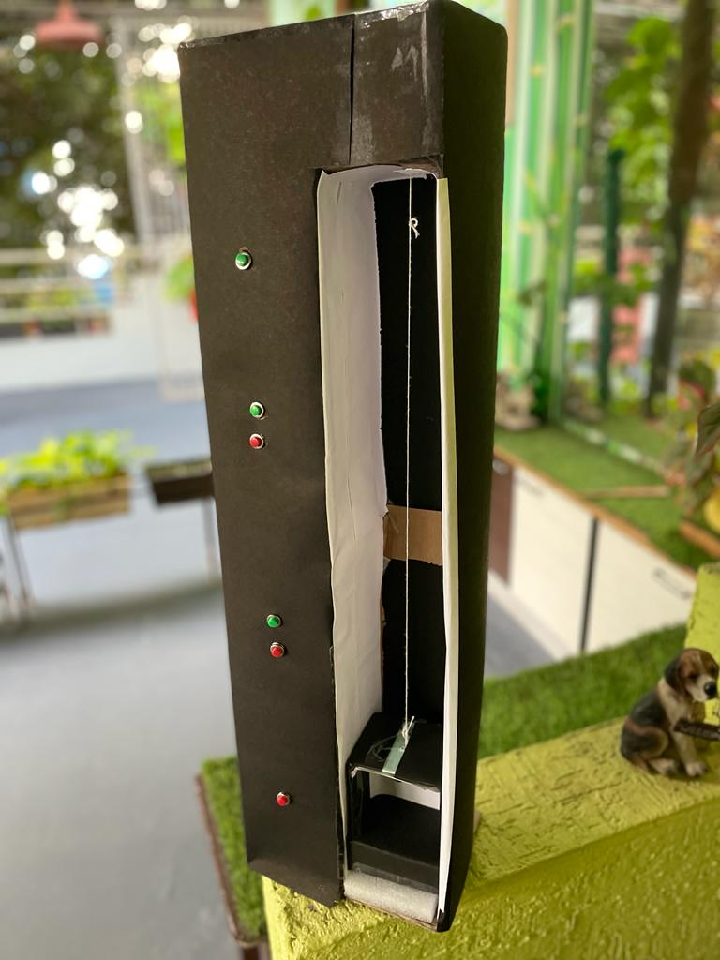
ELEVATOR

Slide 8
THANK YOU

